Slide 1
FEB 2022 VIRTURAL CONFERENCE
DENNIS LYON, CGCS

Slide 2
PLANNING FOR RETIREMENT IS PLANNING FOR YOUR FUTURE

Slide 3
MY BACKGROUND
GRADUATED COLORADO STATE UNIVERSITY IN HORTICULTURE, 1970
MASTERS DEGREE IN MANAGEMENT FROM UNIVERSITY OF NORTHERN COLORADO, 1976
CERTIFIED SUPERINTENDENT SINCE 1979
GCSAA PRESIDENT IN 1989
CAREER INCLUDED 37 YEARS AS MANAGER OF GOLF FOR THE CITY OF AURORA COLORADO
WAS A TRUSTEE ON TWO DEFINED BENEFIT PENSION PLANS FOR 15 YEARS

Slide 4
OPENING COMMENTS ON RETIREMENT
THE SUBJECT OF PLANNING FOR RETIREMENT HAS BEEN ONE OF MY RECENT PASSIONS
CITY OF AURORA PROVIDED A DEFINED BENEFIT PENSION PLAN, I RETIRED IN 2010
DURING MOST OF MY CAREER I KNEW NOTHING ABOUT PLANNING FOR RETIREMENT
GCSAA’S ROLE IN HELPING SUPERINTENDENTS PLAN FOR RETIREMENT

Slide 5
PLANNING FOR YOUR RETIREMENT FUTURE
MY RETIREMENT EDUCATION
INITIALLY I WAS NOT INVOLVED IN PLANNING FOR MY RETIREMENT. I CONTRIBUTED (MANDITORY) ABOUT 6% OF MY SALARY, TAX DEFERRED, AND THE PLAN MANAGED ALL INVESTMENTS AND ADMINISTRATION.
CITY ALSO PARTICIPATED IN SOCIAL SECURITY.
IN 2003, I WAS ELECTED BY OTHER EMPLOYEES TO THE CITY OF AURORA RETIREMENT PLAN.
APPOINTED TO THE ARAPAHOE COUNTY, BOARD OF RETIREMENT
IN 2012.
15 YEARS EXPERIENCE AS A PENSION PLAN FIDUCIARY.

Slide 6
QUESTIONS AND CONCERNS ABOUT RETIREMENT
WHY DO I NEED TO PLAN FOR RETIREMENT NOW, MY LIFE CURRENTLY DEMANDS ALL OF MY INCOME?
HOW MUCH DO I NEED TO SAVE FOR RETIREMENT?
WHAT RETIREMENT PLAN WORKS BEST FOR ME?
FINANCIAL INVESTING IS NOT MY FORTE, WHAT DO I DO?
I INTEND TO WORK UNTIL I DIE, WHY SHOULD I PLAN
FOR RETIREMENT?
THE TRANSITION TO RETIREMENT IS A SIGNIFICANT
LIFE ADJUSTMENT.

Slide 7
CONCERNS AND QUESTIONS ABOUT RETIREMENT
HOW DOES SOCIAL SECURITY WORK?
WHEN CAN OR WHEN SHOULD I COLLECT FROM
SOCIAL SECURITY?
WHAT DO I DO ABOUT HEALTH CARE WHEN I RETIRE?
WHEN CAN I SIGN-UP FOR MEDICARE AND HOW MUCH WILL IT COST?
I LOVE MY JOB I DON’T KNOW WHEN I WILL RETIRE.

Slide 8
PLANNING FOR YOUR RETIREMENT FUTURE
ACCORDING TO SOCIAL SECURITY, A MALE BORN IN 1990 CAN, ON AVERAGE, EXPECT TO LIVE TO AGE 87.
HOW MANY SUPERINTENDENTS, STILL WORKING AS A SUPERINTENDENT, OVER AGE 75, DO YOU KNOW?
PREPARGING FOR RETIREMENT, LIKE MOST OF LIFE’S PROJECTS, REQUIRES COMMITMENT AND PLANNING.
CONSIDER DEVELOPING A FINANCIAL PLAN TO
FUND RETIREMENT.

Slide 9
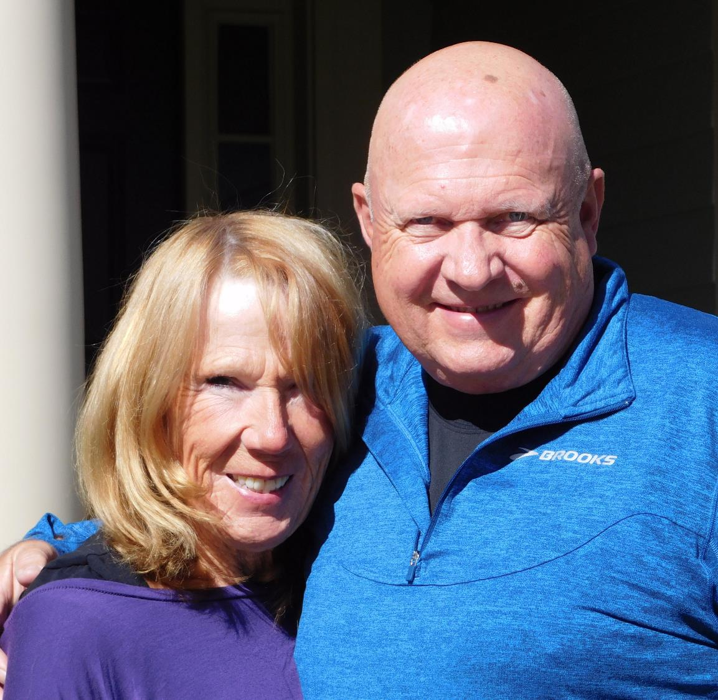
NOW RETIRED FOR OVER 10 YEARS, MY COST OF LIVING HAS NOT CHANGED THAT MUCH.
RETIREMENT SHOULD BE A SUCCESSFUL AND REWARDING PART OF ONE’S LIFE EXPERIENCE
PLANNING FOR RETIREMENT IS A FAMILY DECISION AND A RESPONSIBILITY.

Slide 10
LIFE’S THREE TRANSITION PHASES
EARLY LIFE: GROWTH AND EDUCATION PHASE
MID-LIFE ADULT: FAMILY, JOB AND CAREER PHASE
SENIOR ADULT: MATURE, AGING PHASE

Slide 11

“THAT DAY”
WHETHER PLANNED, OR DUE TO A SUDDEN CHANGE IN EMPLOYMENT, “THAT DAY” IS PROBABLY IN YOUR FUTURE

Slide 12
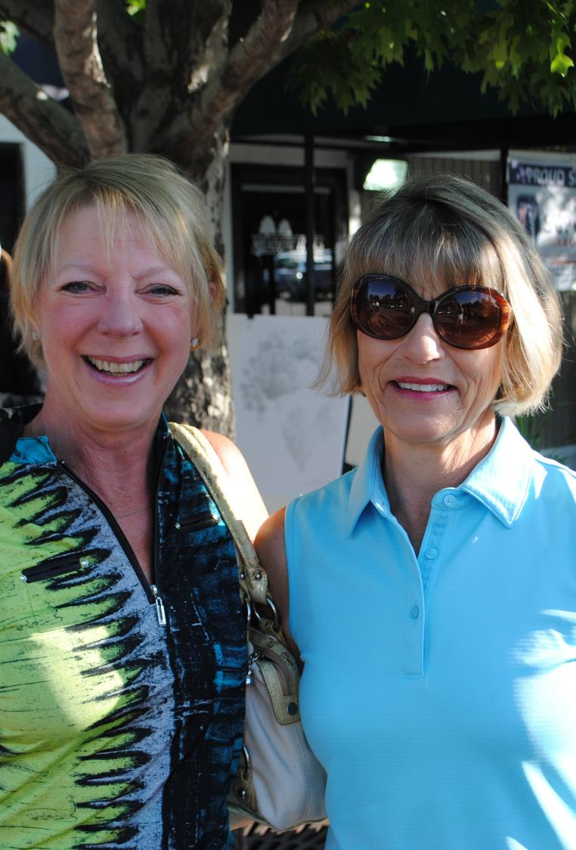
AMERICANS ARE NOT PLANNING FOR RETIREMENT
ACCORDING TO A NORTHWESTERN MUTUAL STUDY:
Only 16% of adults surveyed have saved $200,000
or more for retirement
One in 5 Americans has less than $5,000
15% have saved nothing at all

Slide 13
GCSAA MEMBER SURVEY FROM 2016
95% OF MEMBERS WHO RESPONDED ARE SAVING FOR RETIREMENT.
88% SAID FINANCIAL ISSUES ARE A COMMON CAUSE OF
WORKLIFE STRESS.
52% STATED THEY INTEND TO CONTINUE WORKING BEYOND NORMAL RETIREMENT AGE.
80% OF RESPONDING MEMBERS ARE INTERESTED IN GCSAA OFFERING A MEMBER FINANCIAL PLANNING SERVICE.
  GCSAA IMPLEMENTED A RETIREMENT PLATFORM, ON ITS MEMBER WEBPAGE, SPRING OF 2021.

Slide 14
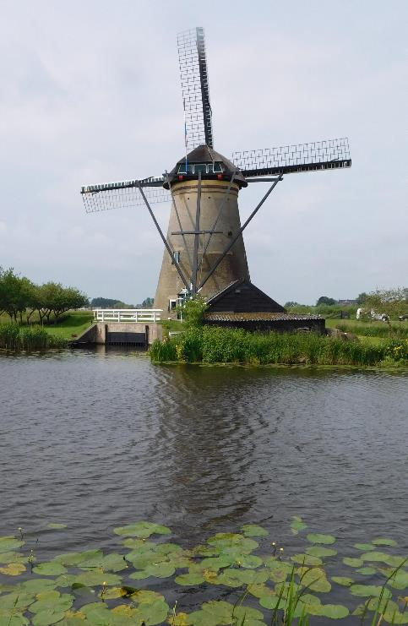
RETIREMENT CAN BE LIKE BEING UNEMPLOYED FOR 20 YEARS
ACCORDING TO AN ARTICLE IN USA TODAY, “RETIREMENT IS LIKE 20 YEARS OF UNEMPLOYMENT.”
THE FINANCIAL IMPLICATIONS OF RETIREMENT ARE REAL.
ONE’S FUTURE LIFESTYLE IS DEPENDENT ON FINANCIAL DECISIONS, INVESTMENTS, AND ACTIONS TAKEN, WELL IN ADVANCE OF RETIREMENT. 40 for 20!

Slide 15
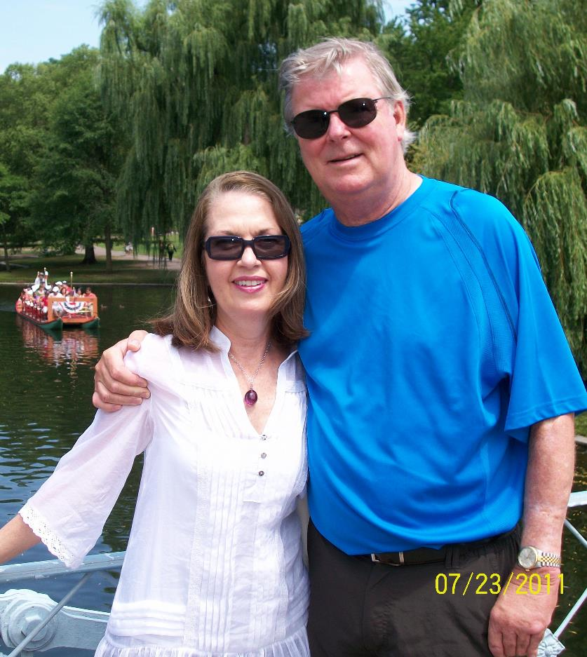
WHAT RETIREMENT REALLY IS:
IT IS THE PHASE OF LIFE FOLLOWING OUR WORKING WHAT
RETIREMENT AND AGING ARE LIFE’S NEXT PHASE, AFTER ONE’S WORKING AND CAREER PHASE.
MOVING FROM ONE’S WORKING PHASE TO RETIREMENT, IS A PERSONAL AND FAMILY TRANSITION.

Slide 16
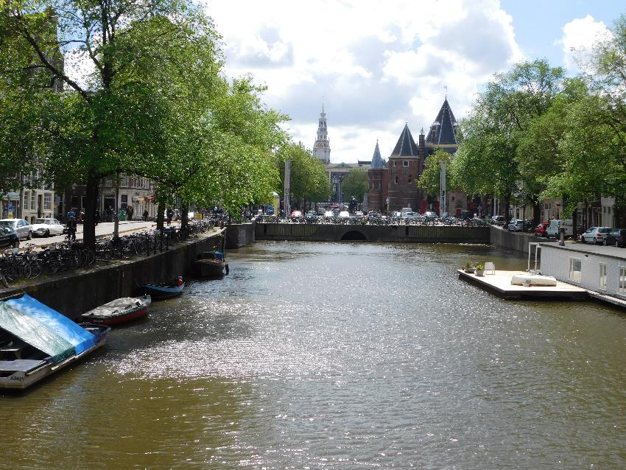
WHAT RETIREMENT CAN BE
Watching sunrise with a cup of coffee and knowing the rest of the day is yours.
A round of golf with friends or a pleasant walk,
Or perhaps spending time reading a good book,
Or a part-time job working at a golf course up the street.

Slide 17
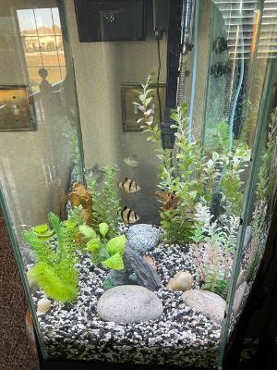
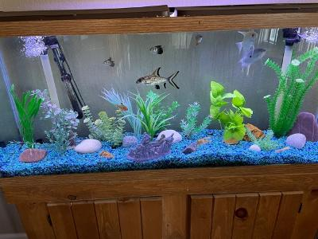
RETIREMENT MEANS GETTING TO ENJOY DOING THINGS WHICH YOU HAVE NOT HAD TIME FOR, IN THE PAST

Slide 18

TAKING THE STEPS IN PLANNING FOR RETIREMENT
FINANCIAL INVESTING IS A COMPLEX TOPIC
NOT A SUBJECT ADDRESSED IN “TURF SCHOOL”
MAKE THE TOUGH DECISIONS
THE COST OF LIVING IS ALWAYS
A PROBLEM
ENGAGE A FINANCIAL CONSUTANT

Slide 19
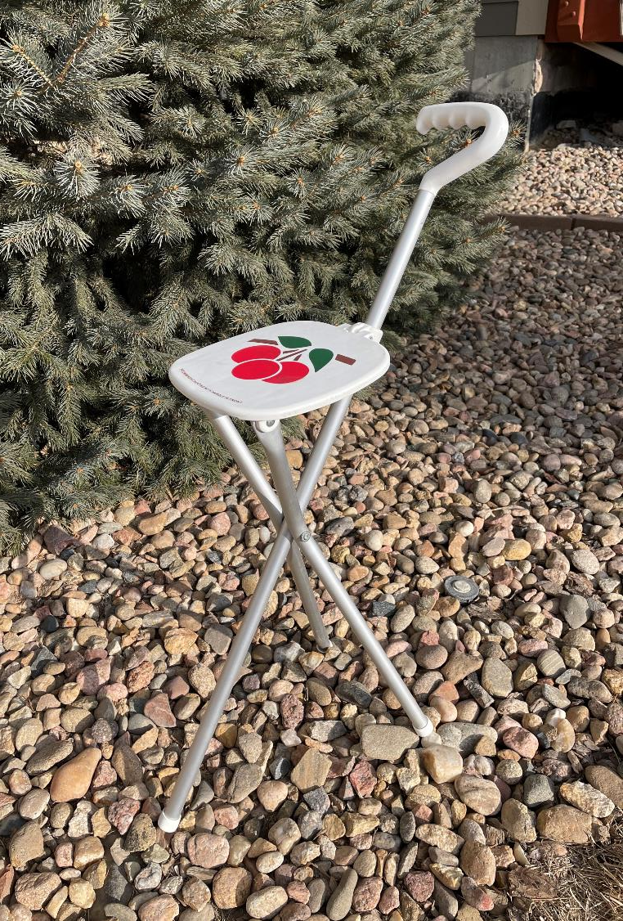
THE THREE-LEGGED STOOL OF RETIREMENT
RETIREMENT
SOCIAL SECURITY
SAVINGS AND PERHAPS PART-TIME EMPLOYMENT

Slide 20
PENSION PLANNING 101
THREE TYPES OF RETIREMENT PLANS
DEFINED BENEFIT PLANS
DEFINED CONTRIBUTION PLANS
IRAs INDIVIDUAL RETIREMENT ACCOUNTS

Slide 21
DEFINED BENEFIT PENSION PLAN:
A PLAN IN WHICH AN EMPLOYER/SPONSOR, MAKES A SPECIFIC PENSION CONTRIBUTION, ESTIMATE (6%-9%)
CONTRIBUTION USUALLY MATCHED BY THE EMPLOYEE
MUST MEET AGE REQUIREMENT: EXAMPLE; RULE OF 80 FOR FULL PENSION, AGE PLUS YEARS OF SERVICE

Slide 22
DEFINED BENEFIT PENSION PLAN:
PARTICIPANT HAS ZERO INPUT ON INVESTMENT MANAGEMENT
PENSION GUARANTEED FOR LIFE, BEFORE TAXES
RETIREMENT IS BASED ON A FORMULA: EARNINGS, LENGTH OF SERVICE AND A MULTIPLYER

Slide 23

DEFINED CONTRIBUTION RETIREMENT PLAN:
A PLAN IN WHICH EMPLOYEES CONTRIBUTE AN AMOUNT OF MONEY, USUALLY A PERCENT OF SALARY, TO
AN EMPLOYER SPONSORED RETIREMENT PLAN.
EMPLOYERS MAY OR MAY NOT CONTRIBUTE.
INVESTMENT DECISIONS, INCLUDING RISK, USUALLY MADE BY PARTICIPANT.

Slide 24

DEFINED CONTRIBUTION PLANS:
401(k) for profit companies
403(b) or (457b) which are for employees from nonprofit companies
GCSAA offers employees a 401c(6) which is a “membership-based plan” with a 4% match

Slide 25
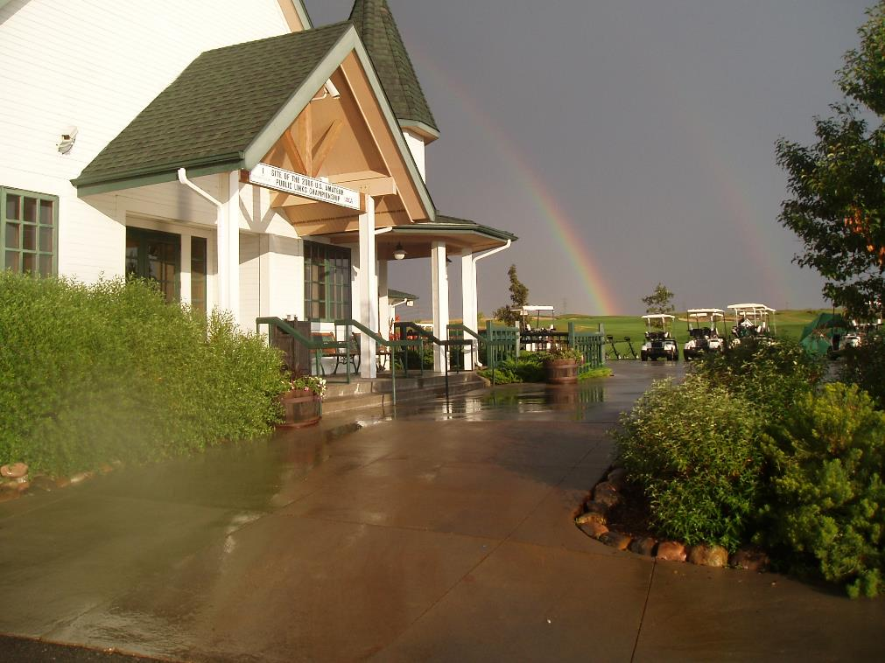
DEFINED CONTRIBUTION RETIREMENT PLAN
FUNDING IS FINITE (CAN RUN OUT OF FUNDS.)
MAXIMUM ANNUAL CONTRIBUTION IN 2021 $19,500, PLUS $6,500 CATCH UP, IF OVER AGE 50.
MANDATORY WITHDRAWL STARTING AT AGE 72 ABOUT 4% MINIMUM EACH YEAR.

Slide 26
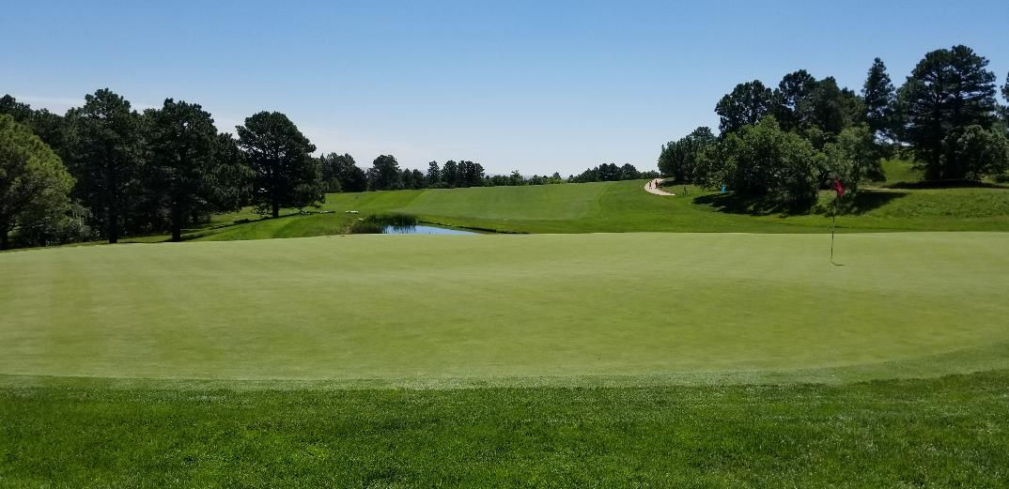
INDIVIDUAL RETIREMENT ACCOUNTS
IRA - A TAX-ADVANTAGE INVESTMENT TOOL THAT INDIVIDUALS USE TO EARMARK FUNDS FOR RETIREMENT SAVINGS

Slide 27
INDIVIDUAL RETIREMENT ACCOUNTS
Traditional IRAs (PRE-TAX EMPOYEE SELF FUNDED)
Roth IRAs (POST-TAX RETIREMENT INVESTMENT)
Simple IRAs (SAVINGS INCENTIVE MATCH PLAN FOR EMPLOYEES, MATCH EMPLOYER CONTRIBUTION UP TO 3%)

Slide 28

RETIREMENT CALCULATION
401(k)
DRAFT CALCULATION
GOAL IS TO RETIRE WITH $2,000 PER MONTH FROM RETIREMENT SAVINGS

Slide 29
INVESTING IN YOUR FUTURE
RETIREMENT GOAL IS $2,000 PER MONTH
Age: 30
Anticipated Retirement Age: 70
Assume 7% Annual Return on Investments
Per “Vanguard” Actuarial Calculation – Required Payroll Contribution is $540/month or $6,500/year
Age: increased from 30 to 45
Retirement age 70
Assume 7% annual return on investment
Payroll Contribution increases to $1,167/month or $14,000/year

Slide 30
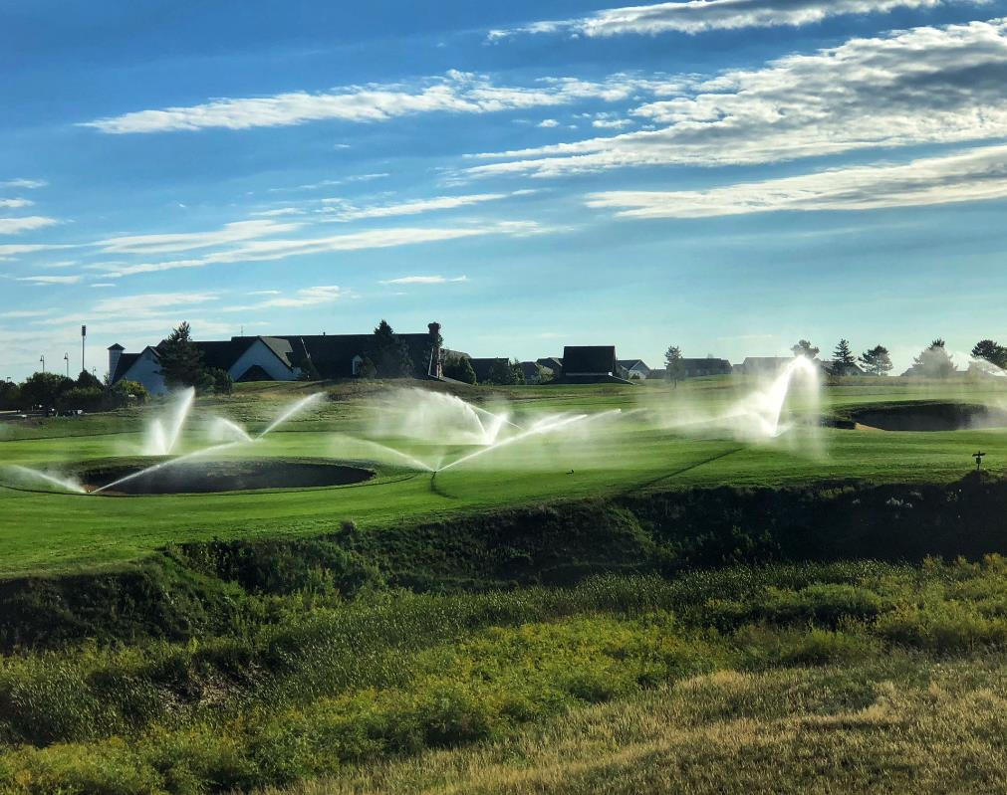
THE TIME VALUE OF MONEY
TIME IS YOUR FRIEND IN RETIREMENT FINANCIAL PLANNING.
START WITH AN “INVESTMENT PLAN.” THE AMOUNT INVESTED CAN INCREASE OVER TIME.
THE EARLIER YOU BEGIN, THE MORE YOUR INVESTMENT, AND ITS INTEREST, WILL WORK
FOR YOU.
THE AMOUNT INITIALLY SAVED CAN DOUBLE OR TRIPLE IN VALUE, OVER TIME.

Slide 31
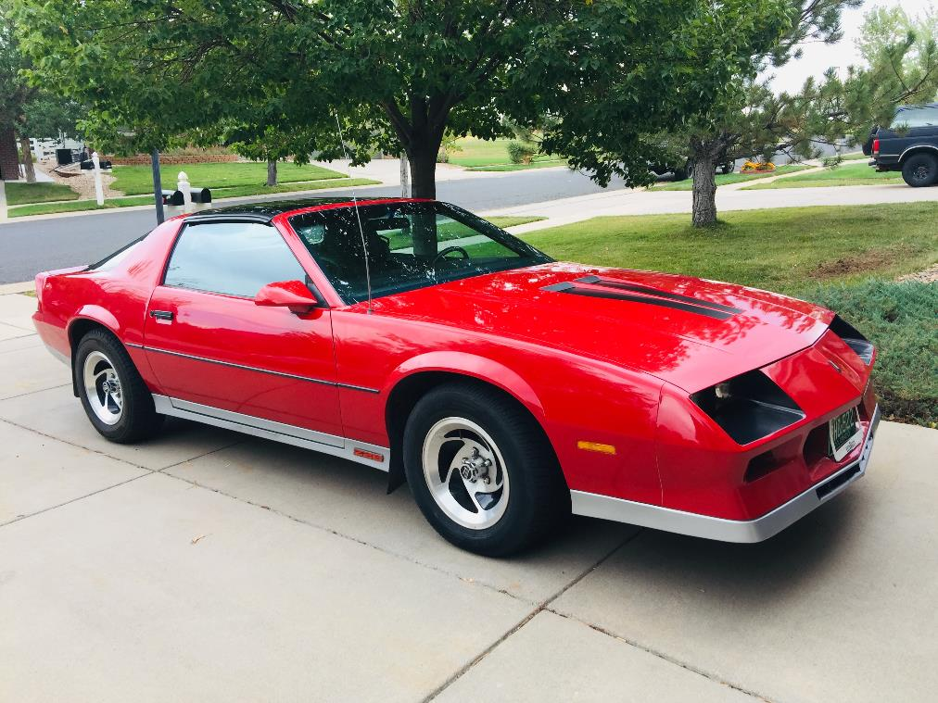
WHAT HAVE WE COVERED?
WHY PLANNING FOR RETIREMENT IS SO IMPORTANT
RETIREMENT PLANNING IS A FAMILY RESPONSIBILITY
THAT DAY WILL COME
TYPE OF PENSION PLANS
DEVELOPING AN INVESTMENT PLAN
THE TIME VALUE OF MONEY
THE THREE-LEGGED STOOL OF RETIRMENT
RETIREMENT CALCULATIONS

Slide 32
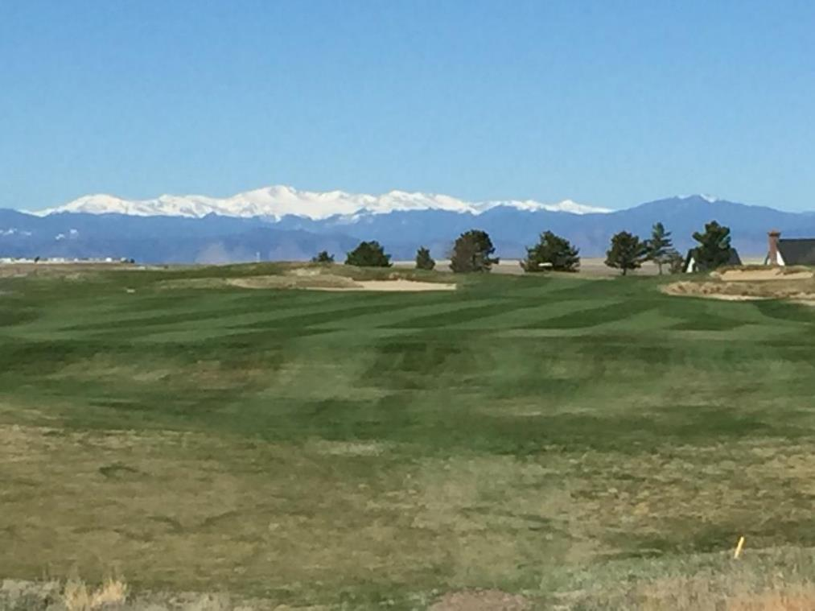
INVESTMENTS
GENERAL INFORMATION ON INVESTING
FOR RETIREMENT

Slide 33

INVESTMENT VOCABULARY, (IV)
INVESTMENT VOCABULARY
EQUITIES – STOCKS
FIXED INCOME – BONDS
MUTUAL FUNDS
INDEX FUNDS
REAL ESTATE
(Include your home)

Slide 34
INVESTMENT VOCABULARY, (IV)
INVESTMENT VOCABULARY
TARGET DATE ALLOCATION
LIFE ANNUITY
DIVERSIFICATION
HEDGE FUNDS

Slide 35
INVESTMENT VOCABULARY, (IV)
RETIREMENT VOCABULARY
US INVESTMENTS
INTERNATIONAL INVESTMENTS
GLOBAL INVESTMENTS
EMERGING MARKETS

Slide 36
MARKET CAPITAL
LET’S HAVE SOME FUN ON THE SUBJECT OF MARKET CAPITAL.
I AM SURE EVERYONE IS WONDERING ABOUT MARKET CAPITAL.

Slide 37
FAMILY FUED ON STOCK EQUITIES
CALLAWAY FAMILY vs THE TITELEST FAMILY
QUESTION ON MARKET CAPITAL SIZE:
  LARGE CAPITAL
  MID CAPITAL
  SMALL CAPITAL
  COMPANY VALUE DETERMINED BY PRICE OF STOCK TIMES THE TOTAL NUMBER OF STOCKS IN THE MARKET
  QUESTION: WHAT IS THE MINIMUM VALUE OF A COMPANY TO BE CLASSIFIED AS A LARGE-CAP STOCK?

Slide 38
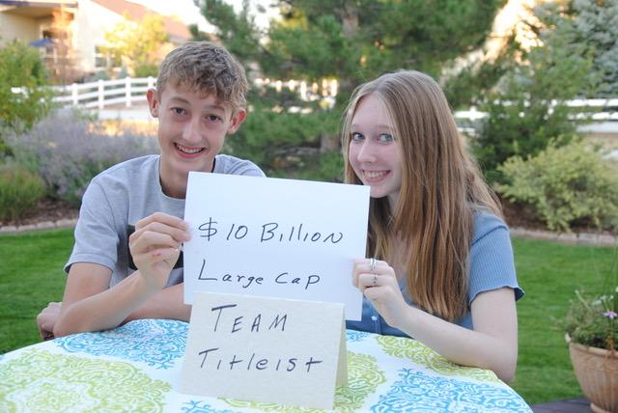
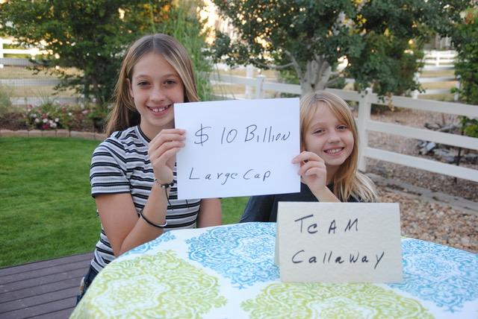
TEAM TITLEIST vs TEAM CALLAWAY

Slide 39
SURVEY SAYS
MINIMUM VALUE OF LARGE CAP COMPANY IS:
10 Billion Dollars

Slide 40
FAMILY FUED ON STOCK EQUITIES
CALLAWAY FAMILY vs THE TITELEST FAMILY
QUESTION ON MARKET CAPITAL SIZE:
  LARGE CAPITAL
  MID CAPITAL
  SMALL CAPITAL
  QUESTION: WHAT IS THE MINIMUM VALUE OF A COMPANY TO BE CLASSIFIED AS A MID-CAP STOCK?

Slide 41
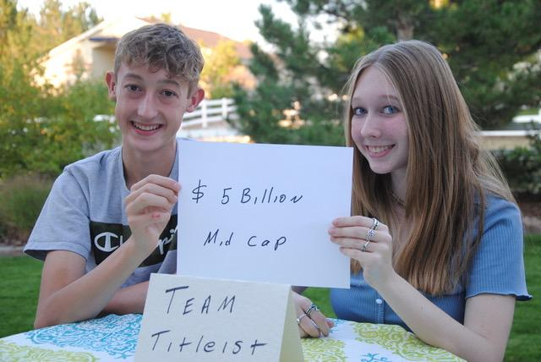
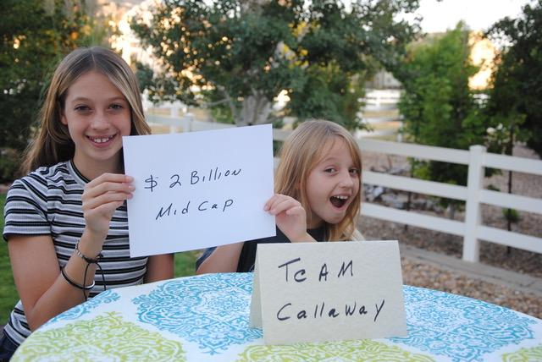
TEAM TITLEIST vs TEAM CALLAWAY

Slide 42
SURVEY SAYS
MINIMUM VALUE OF A
MID-CAP STOCK
2 Billion Dollars

Slide 43
TEAM TITLEIST vs TEAM CALLAWAY

Slide 44
FAMILY FUED ON STOCK EQUITIES
CALLAWAY FAMILY vs THE TITELEST FAMILY
QUESTION ON MARKET CAPITAL SIZE:
  LARGE CAPITAL
  MID CAPITAL
  SMALL CAPITAL
  QUESTION: WHAT IS THE MINAMUM VALUE OF A COMPANY TO BE CLASSIFIED AS A SMALL-CAP STOCK?

Slide 45
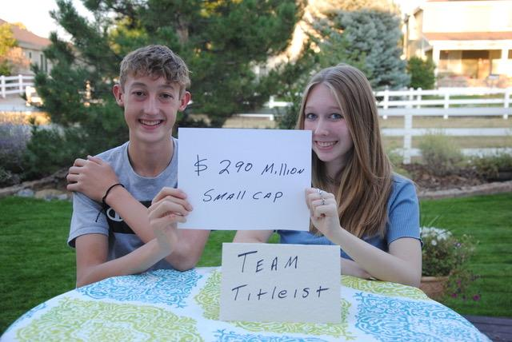
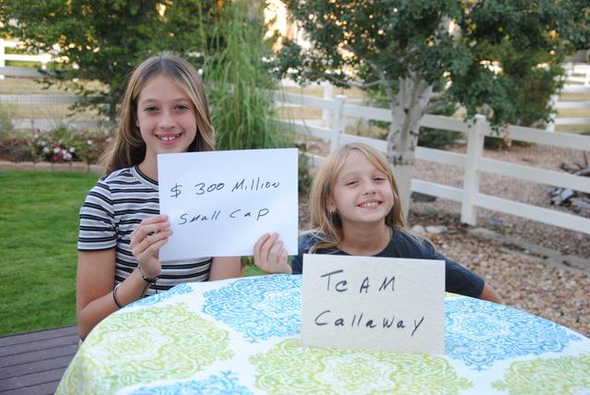
TEAM TITLEIST vs TEAM CALLAWAY

Slide 46
SURVEY SAYS
MINAMUM VALUE OF A SMALL-CAP STOCK
300 MILLION Dollars

Slide 47
TEAM TITLEIST vs TEAM CALLAWAY

Slide 48
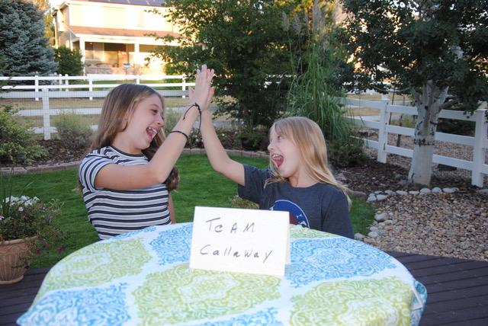

FAMILY FUED WINNERS & LOOSERS

Slide 49

SPECIAL THANKS TO OUR FAMILY FUED PARTICIPANTS!
LARGE CAP STOCKS (MARKET CAPITALIZATION) WORTH $10 BILLION PLUS
MID CAP STOCKS
$2-$10 BILLION
SMID (MID CAP, SMALL CAP COMBO)
SMALL CAP STOCKS $300 MILLION TO
$2 BILLION

Slide 50


TYPES OF LARGE CAP STOCKS
JOHNSON AND JOHNSON
EXON
BANK OF AMERICA
PROCTER AND GAMBLE
NETFLIX
AMAZON
FACEBOOK

Slide 51

KEY POINTS
INVESTMENTS HAVE RISK
RISK IS A SERIOUS CONSIDERATION WHEN INVESTING
ALL INVESTMENTS GO “IN” AND “OUT” OF FAVOR DEPENDING ON
THE ECONOMY
DIVERSIFICATION HAS GREAT VALUE

Slide 52
THE THREE-LEGGED STOOL OF RETIREMENT
SOCIAL SECURITY IS ANOTHER LEG OF THE STOOL

Slide 53
SOCIAL SECURITY
SOCIAL SECURITY, FOR ALMOST ALL RETIREES, IS AN IMPORTANT SOURCE OF INCOME.
HOW MUCH DOES SOCIAL SECURITY PAY?
MAXIMUM IS $3,148/MONTH OR $37,776/YR (2021).
I RETIRED AT AGE 62, HAD 30% PENALTY for EARLY WITHDRAWL. MY SOCIAL SECURITY IS ABOUT
$2,100 PER MONTH.

Slide 54
HEALTH CARE AND RETIREMENT
MEDICARE IS A SIGNIFICANT FACTOR IN RETIREMENT
MEDICARE IS AVAILABLE AT AGE 65, GENERALLY CONSIDERED “RETIREMENT AGE.”
COST OF HEALTH CARE FOR A COUPLE WITH AND WITHOUT MEDICARE:
  TWO INDIVIDUALS, AGE 60, COST FOR KAISER HMO - $1,300/MONTH,
  TWO INDIVIDUALS, AGE 65 WITH MEDICARE, COST FOR KAISER HMO - $500/ MONTH
  MEDICARE SAVINGS $800/MONTH

Slide 55
INITIAL QUESTIONS ON RETIREMENT
WHY DO I NEED TO PLAN FOR RETIREMENT NOW, MY LIFE CURRENTLY DEMANDS ALL OF MY INCOME?
HOW MUCH DO I NEED TO SAVE FOR RETIREMENT?
WHAT RETIREMENT PLAN WORKS BEST FOR ME?
FINANCIAL INVESTING IS NOT MY FORTE, WHAT DO I DO?
I INTEND TO WORK UNTIL I DIE, WHY SHOULD I PLAN
FOR RETIREMENT?
THE TRANSITION TO RETIREMENT IS A SIGNIFICANT
LIFE ADJUSTMENT.

Slide 56
INITIAL QUESTIONS ON RETIREMENT
HOW DOES SOCIAL SECURITY WORK?
WHEN CAN OR WHEN SHOULD I COLLECT FROM
SOCIAL SECURITY?
WHAT DO I DO ABOUT HEALTH INSURANCE WHEN I RETIRE?
WHEN CAN I SIGN-UP FOR MEDICARE AND HOW MUCH WILL IT COST?
I LOVE MY JOB I DON’T KNOW WHEN I WILL RETIRE.

Slide 57
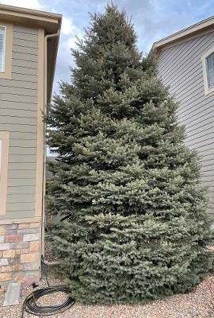
CLOSING THOUGHT
WHEN IS THE BEST TIME TO PLANT A TREE, AND SAVE FOR RETIREMENT?
ANSWER – “20 YEARS AGO!”
WHEN IS THE SECOND-BEST TIME TO PLANT A TREE AND SAVE FOR RETIREMENT?
ANSWER, “TODAY!”

Slide 58
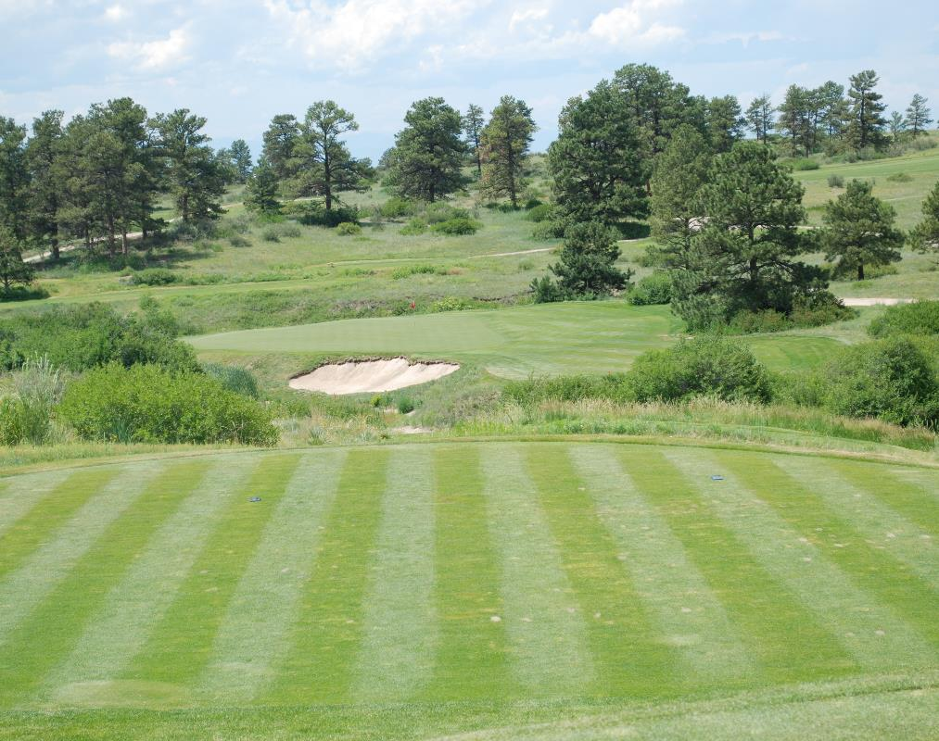
CLOSING THOUGHTS…..
“WHAT DOES THE VALUE OF MONEY HAVE TO DO WITH PLANTING A TREE?”

Slide 59
OUR FUTURE BELONGS TO US
WITH PROPER PLANNING, COMMITMENT AND FINANCIAL ASSISTANCE:
“THE MATURE AGING PHASE OF OUR LIVES CAN BE THE VERY BEST.”

Slide 60
PLANNING FOR RETIREMENT IS PLANNING FOR YOUR FUTURE
THANKS FOR THE OPPORTUNITY TO SHARE MY THOUGHTS AND INFORMATION ON
“PLANNING FOR RETIREMENT IS
PLANNING FOR YOUR FUTURE”
AND VISIT THE “RETIREMENT PLATFORM” ON GCSAA.ORG
DENNIS LYON, CGCS
LYONDENNIS48@aol.com
720-427-1423

